Slide 1

Agribot – Pesticide Spraying Robot
Team Members:
ISHANI (RA2311032010001)
NISHKA (RA2311032010019)
KARAN (RA2311032010035)
SAMARTH (RA2311032010038)

Slide 2
PROBLEM STATEMENT :
Farmers face serious health risks from direct exposure to pesticides during manual spraying, which requires carrying heavy tanks and walking through fields. This traditional method leads to respiratory issues, skin problems, and long-term health hazards, while also being time-consuming, labor-intensive, and unsafe. Despite these challenges, small and medium-scale farmers lack access to affordable, automated spraying solutions, creating a need for a safe, low-cost, and remotely controlled system.

Slide 3
PROPOSED SOLUTION :
Reduces health risks by keeping farmers away from direct pesticide exposure.
Increases efficiency with faster and more uniform spraying across crops.
Low-cost and farmer-friendly, making it affordable for small and medium-scale farmers.
Improves productivity by reducing time spent on manual spraying.
Scalable design with potential to add sensors (moisture, GPS, AI) in future upgrades.
Strong market potential as demand grows for automation in agriculture.

Slide 4
COMPONENTS :
Hardware Components :
ESP8266 (Wi-Fi module + microcontroller) – for wireless Control & connectivity
SG90 Servo Motors × 2 – for spraying/nozzle control
BO Motors (100/150 RPM) × 2 or 4 – for robot movement
L298N Motor Driver × 1 – to drive BO motors
Mini Submersible DC Pump (3–6V) × 1 – for spraying liquid/pesticide
Relay Module (5V Single Channel) × 1 – to control the pump
18650 Battery with Holder (7.4V) – rechargeable power source
Plastic Bottle (as spray tank) – pesticide container
Mini Toggle Power Switch – for power ON/OFF control
ROBOT Chassis Kit (2WD/4WD) – base frame for mounting components
HC-SR04 Ultrasonic Sensor – used for obstacle detection and avoidance by measuring the distance between the robot and nearby objects.
SOFTWARE :
Arduino IDE – programming the code for motor, servo, pump control logic
Blynk Iot App- Connection Hardware to app

Slide 5
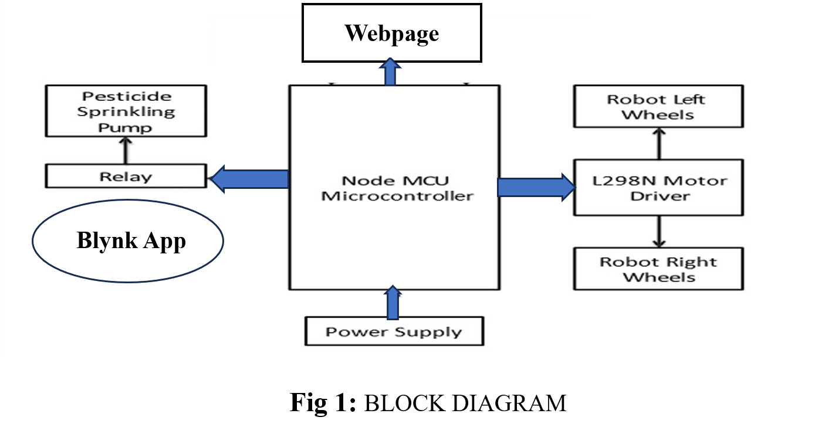
BLOCK DIAGRAM :

Slide 6
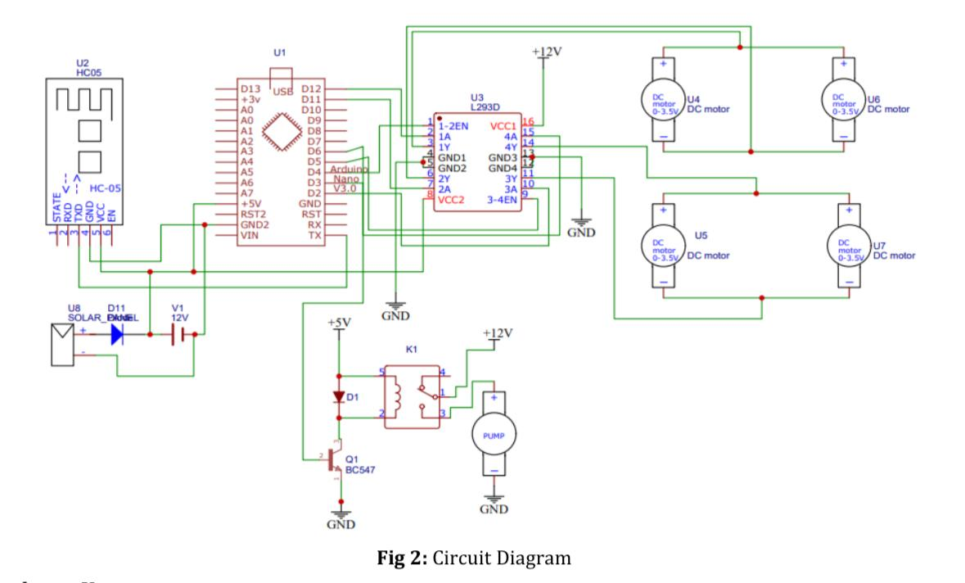
CIRCUIT DIAGRAM :

Slide 7
IMPLEMENTATION :
Wi-fi control: farmer operates robot wirelessly through smartphone app.
Mobility: robot moves in all directions to cover crop rows efficiently.
Automated spraying: dc pump dispenses pesticide when commanded.
Targeted coverage: servo-controlled nozzles adjust spray angle for maximum reach.
Safe operation: farmer stays at a safe distance, avoiding chemical exposure.
Portable power: rechargeable battery ensures continuous field operation.
Field ready: lightweight, compact design makes it easy to deploy in farms.

